Slide 1
Predicting salary based on years of experience

Slide 2
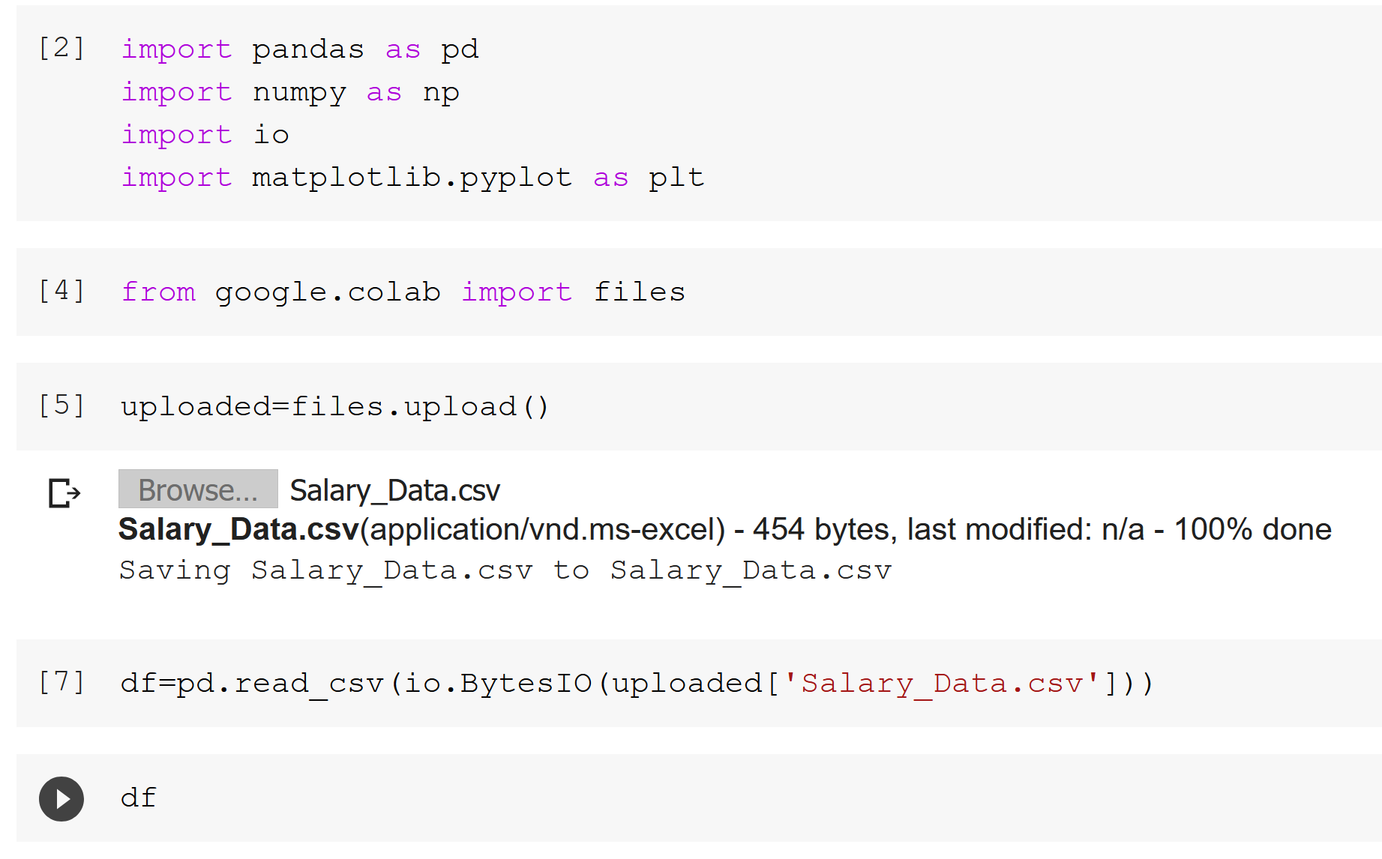
Import libraries and load data

Slide 3
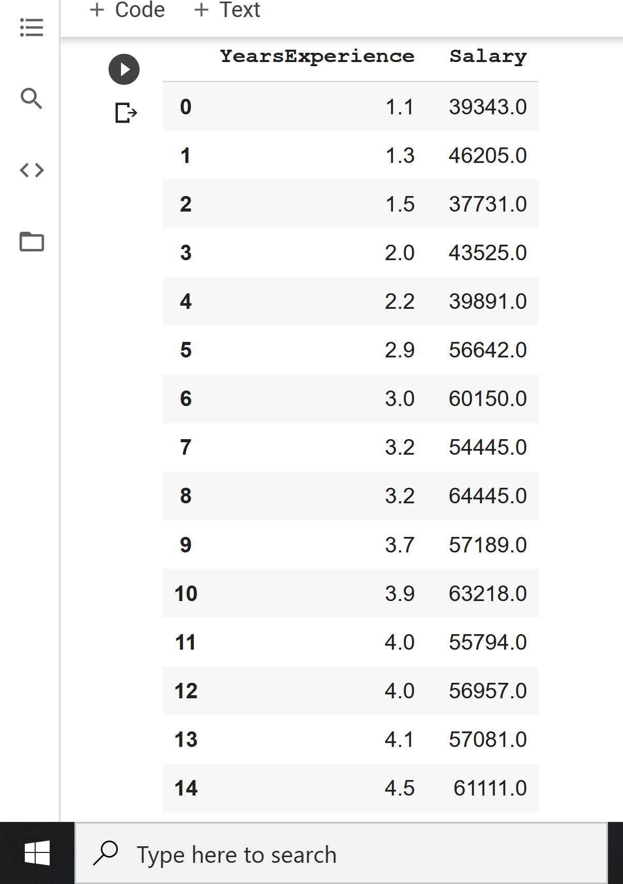

Slide 4
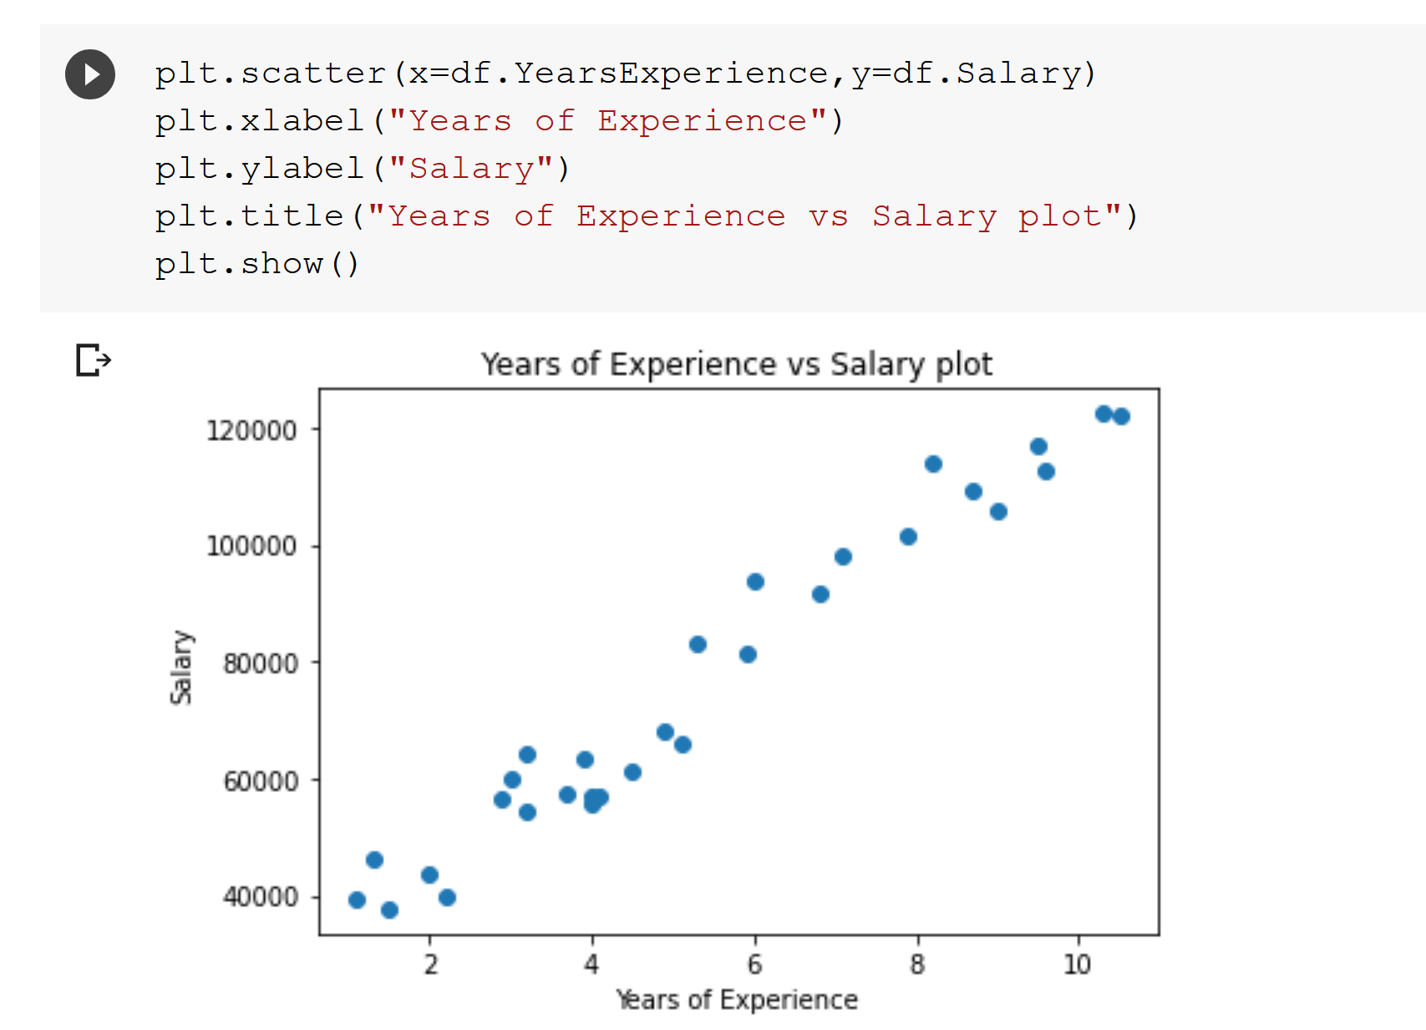
Show it’s a linear relationship

Slide 5
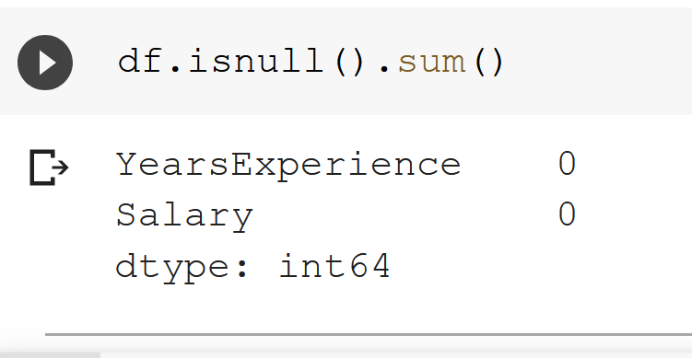
Checking null values

Slide 6
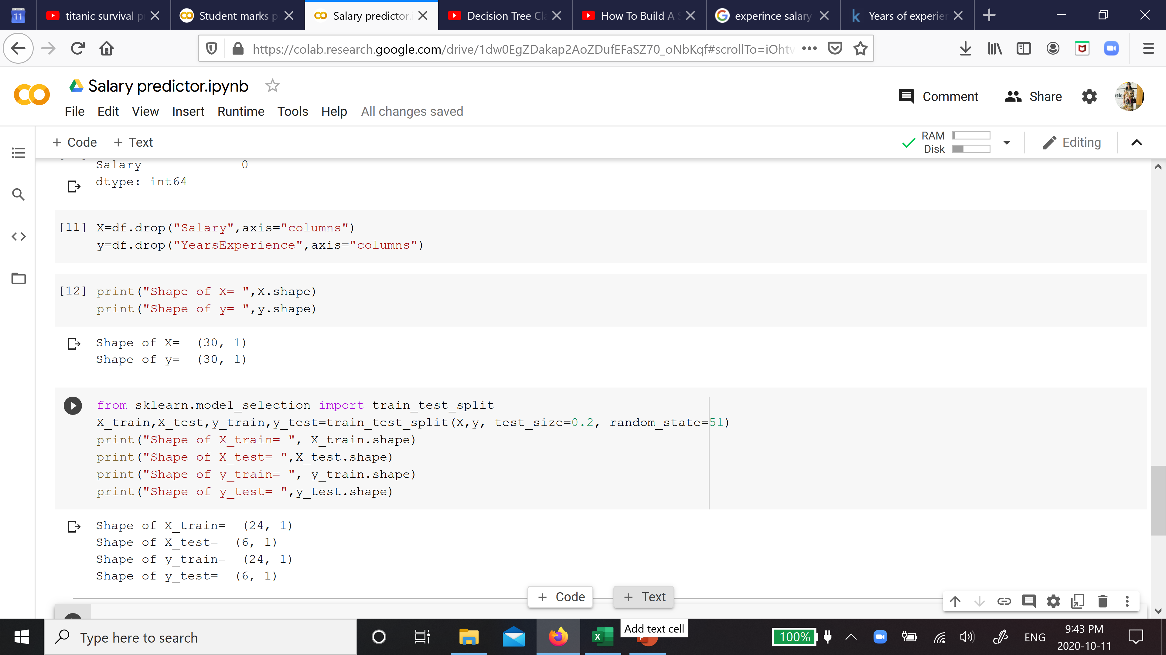
Find X and y and split into test and train dataset

Slide 7
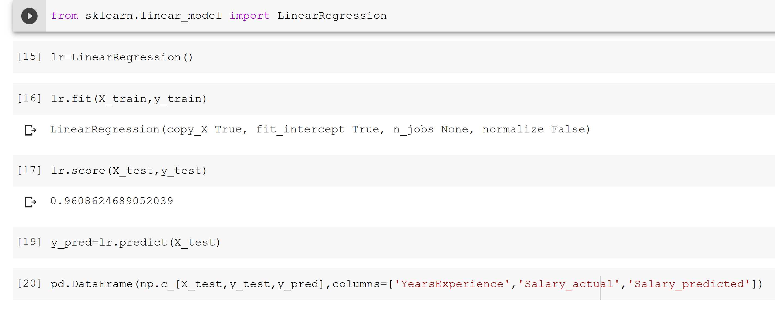
Fit linear regression model, find score, predict test values and compare with actual values

Slide 8
